Slide 1


E-Commerce
Customer
Behavior
Senda Nasr

Slide 2



Agenda
Introduction
Key Findings from Exploratory Data Analysis
Machine Learning Models
Recommendations to Improve User Engagement & Revenue
Next Steps

Slide 3

Introduction
Dataset
Aim of this study :
Identify key features
Improve user engagement
Increase Revenue

Slide 4

Key Findings from Exploratory Data Analysis
Time Spent on Website
Visitor Type
Page Values
Exit Rate
Bounce Rate
Revenue

Slide 5
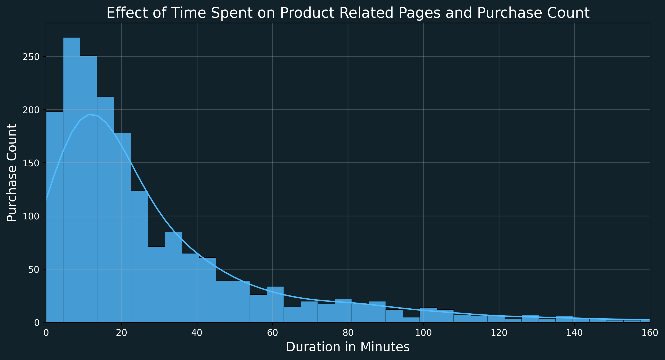
Time Spent on Website

Slide 6
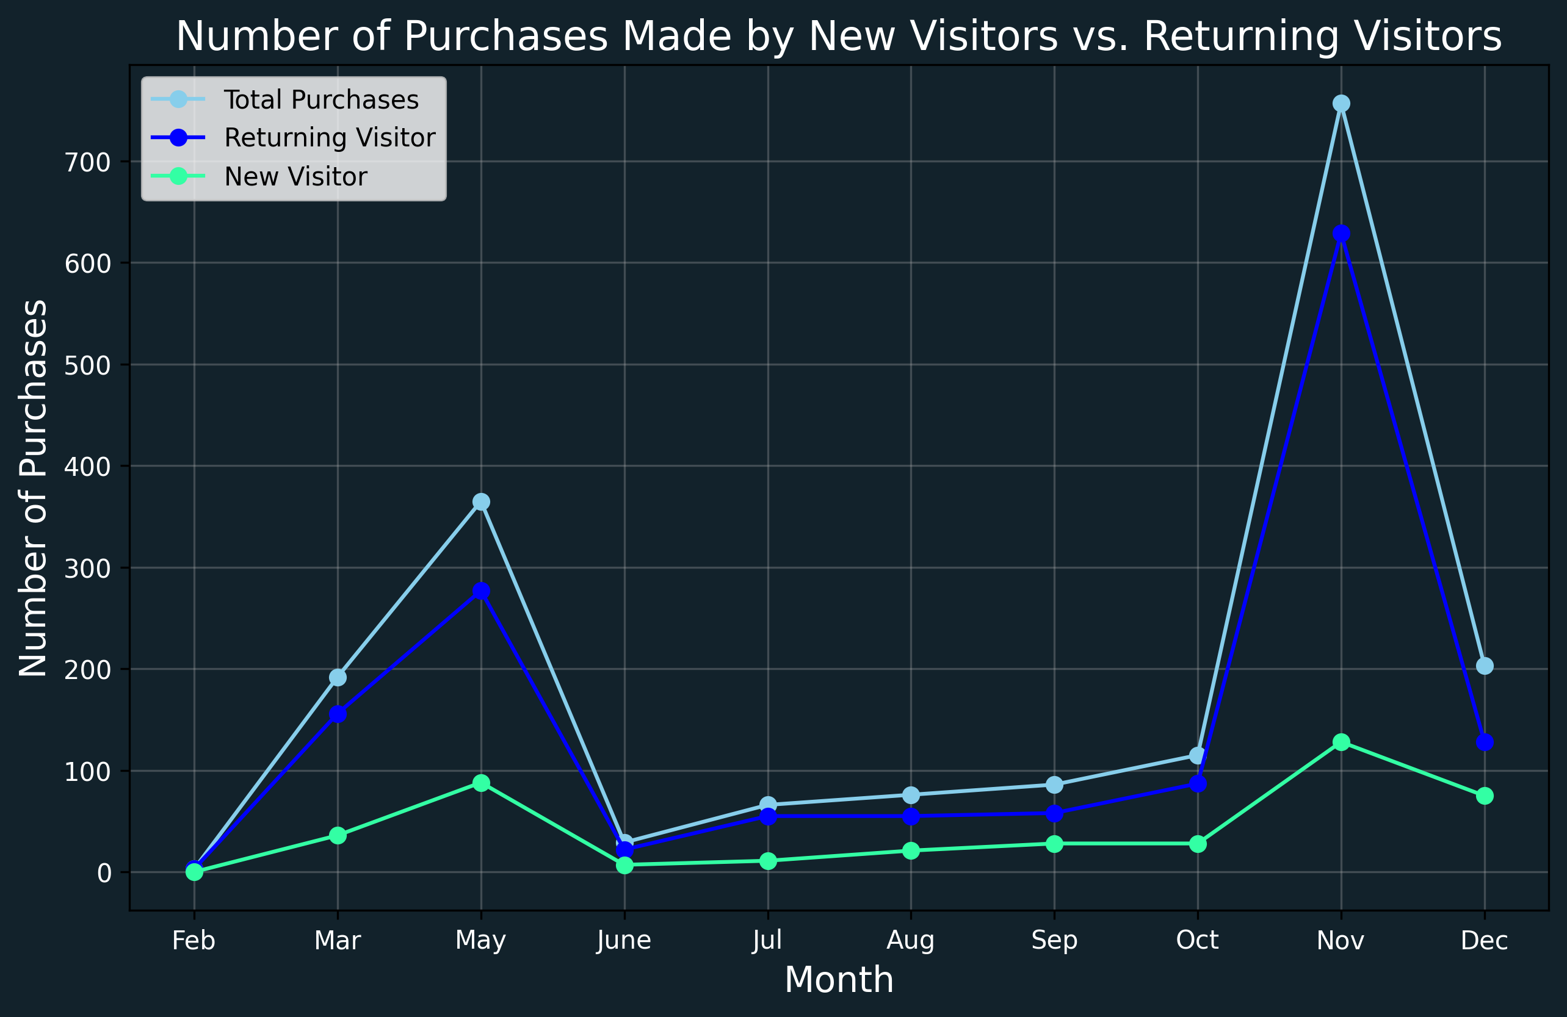
Visitor Type

Slide 7
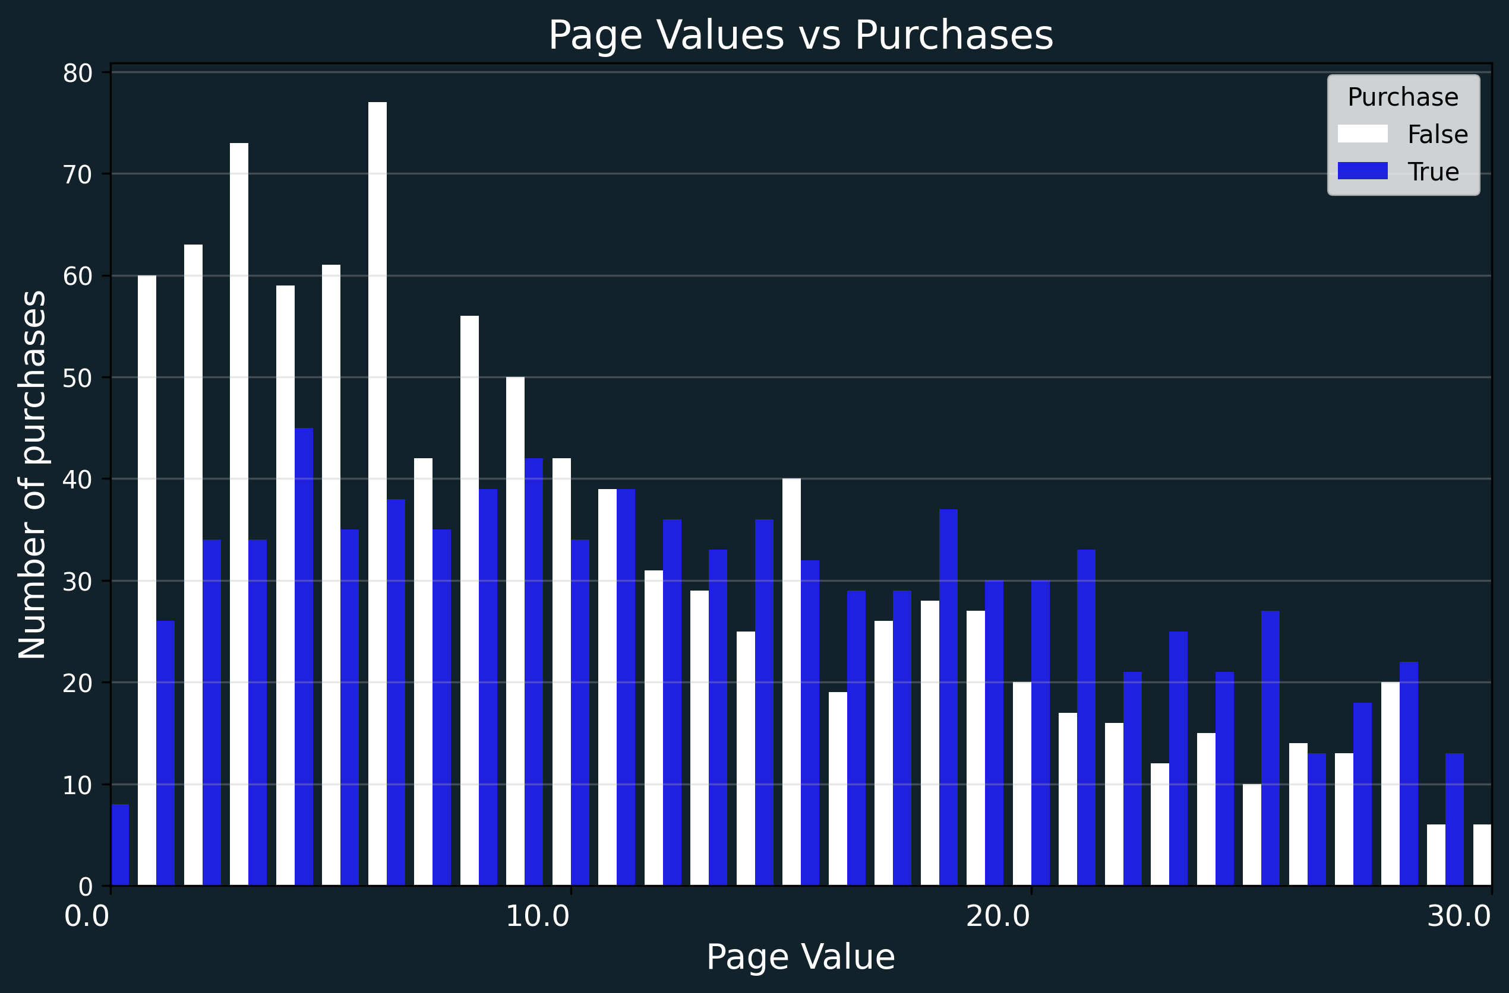
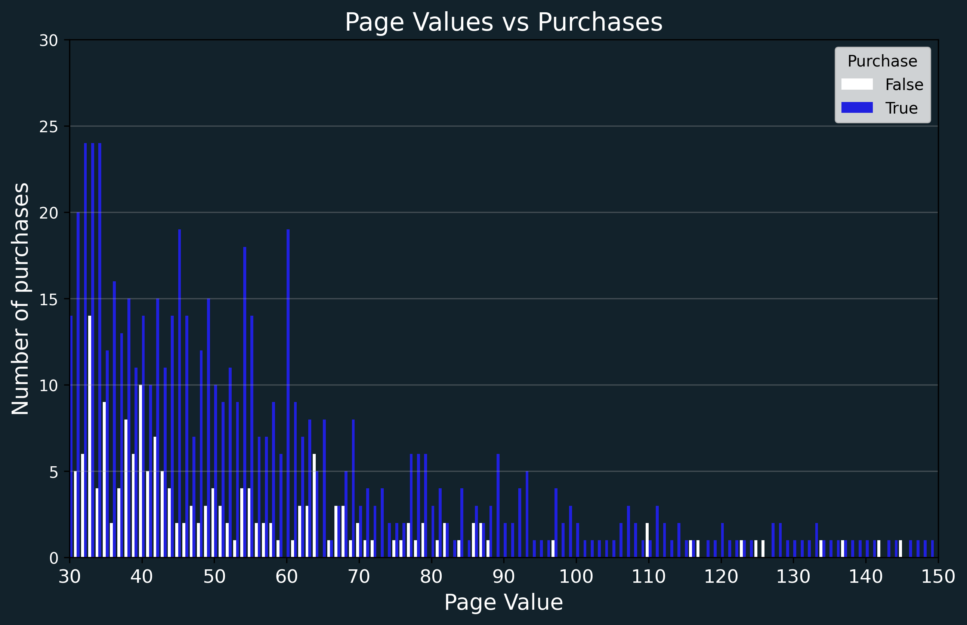
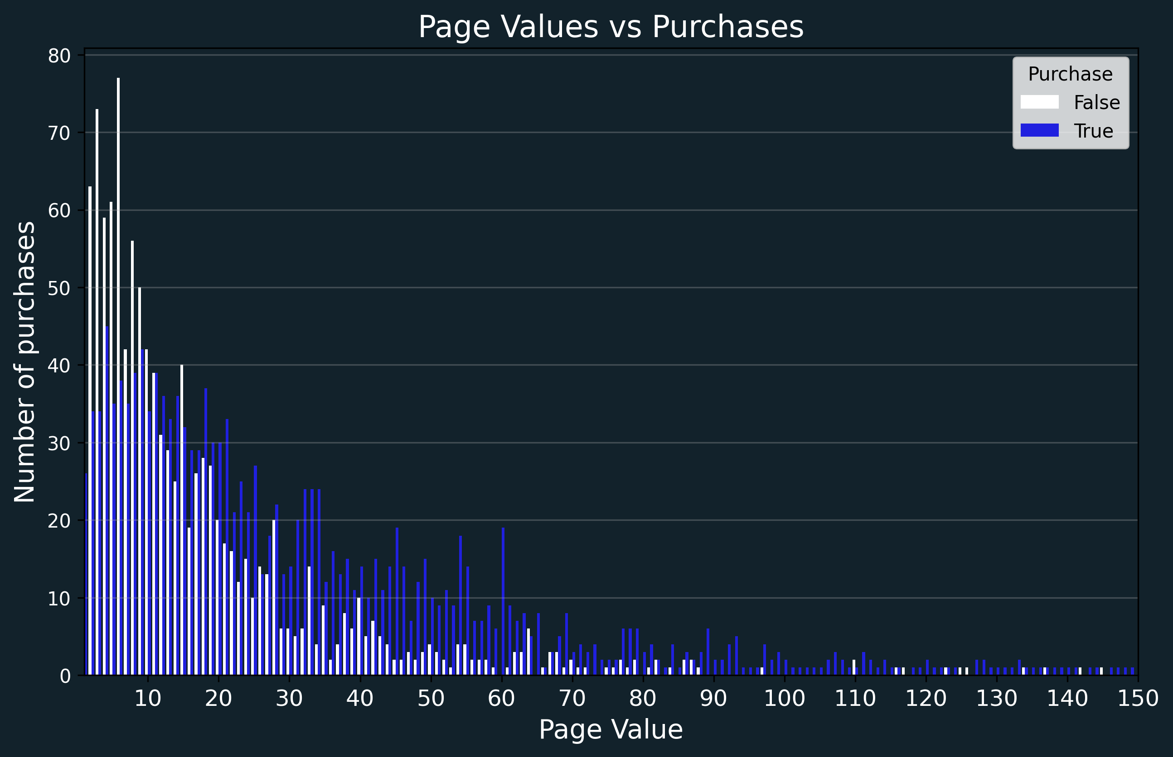
Page Values

Slide 8

Machine Learning Models
Logistic Regression
K Nearest Neighbor
Random Forest Classifier

Slide 9



Recommendations
Increase customer engagement
Attract new customers
This can be achieved by drawing attention through personalized deals.
Ex. First purchase special discount
Notes:
Limited and personalized deals based on time spent by the customer during the session to avoid eno yzh2 w y5la3

Slide 10
Recommendations
Page Value driven improvements
Focus on content of pages with high page value
Improve pages with low page value
Consideration regarding Exit Rate & Bounce Rate
Analyze cause of high Exit & Bounce rate especially if coupled with higher page values
Dynamic analysis of key features
Continuous reassessment based on new data to provide accurate and updated insights
Notes:
Limited and personalized deals based on time spent by the customer during the session to avoid eno yzh2 w y5la3

Slide 11

Next Steps
Analyze customer demographics
Analyze products creating the most revenue
Generate recommendations for customers
Generate recommendations for different business areas

Slide 12
THANK YOU

